Slide 1



DIP392
Simplified Bunco
The Collaboration Feature
Presented by: Omar Fourati & Magnus Schneider

Slide 2
About the Project
First Analysis
Agenda
Software Requirements
Overview of Development Process
Design
Testing
Demonstration

Slide 3


About the Project
Create a version of BUNCO
Objective:
Goals
Develop a user-friendly digital Bunco game for a diverse audience, ensuring easy playability.
User Friendly Design
Smooth Playing Experience
Responsive Design
Enjoyment For Users

Slide 4



Rules
Scoring/Round Features
First Analysis
Progress Display
Requirments
Userfriendly Interface
Broad Playerbase

Slide 5




Software Requirments
User Registration
Difficulty Selection
Game Rule Visualization
Game Initialization
Round Display
Dice Rolling
Score Tracking
Round Progression
Scoring Rules
Usability
Performance
Reliability
Security
Platform Compatibility
Programming Language
Responsive Design

Slide 6

Software Requirments
Result Calculation
Game Termination

Slide 7





Design
Game Elements
Score/Progress
Settings
UI
Notification

Slide 8
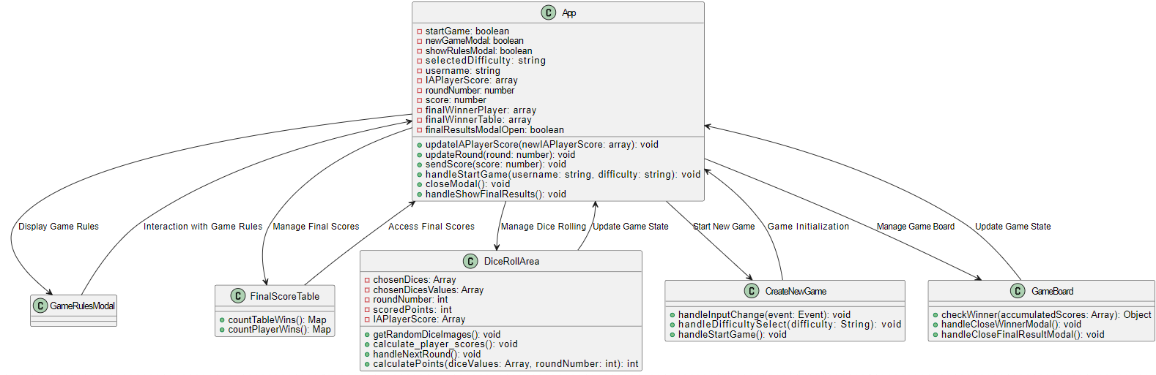
Software Design

Slide 9

Design
1
2
Modular Design
Monolithic Design
Classes and Attributes:
User (username)
GameSettings (difficultyLevel)
Tutorial
Game
Round (roundNumber, currentPlayers)
Dice (value)
Scoreboard (scores, bestTable, bestPlayer)
Scoring (roundScore, totalScore)
UI (displayMessage)
Security (validatedInput)
GameResult (winner, endStatus)
Classes and Attributes:
Settings (difficultyLevel)
GameSettings
Tutorial
Game
User (userName)
Round (roundNumber, currentPlayers)
Dice (value)
Scoreboard (scores, bestTable, bestPlayer)
Scoring (roundScore, totalScore)
UI (displayMessage)
Security (validatedInput)
GameResult (winner, endStatus)
Complexity
Inter-Class Communication
Encapsulation
Maintanance
Less Modular
Maintanance/Scaling
Straightforward
All in One

Slide 10
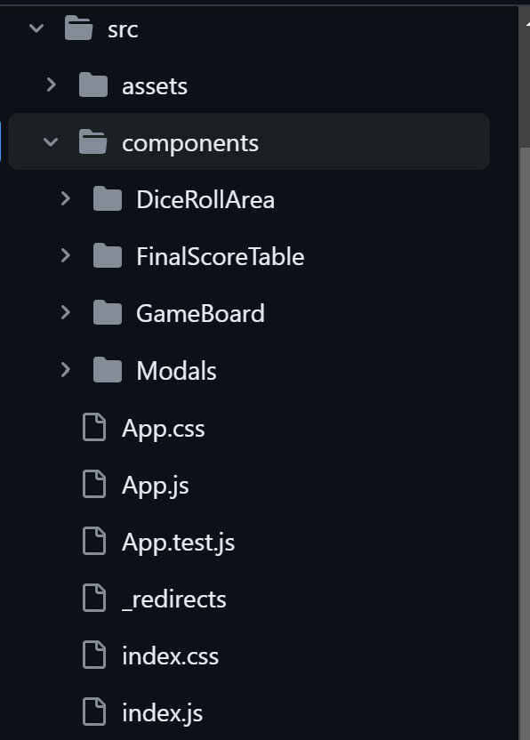
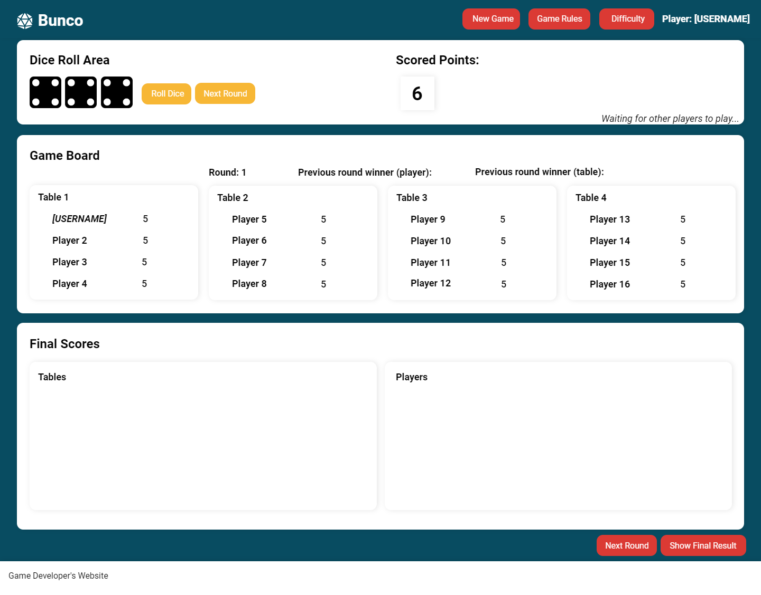
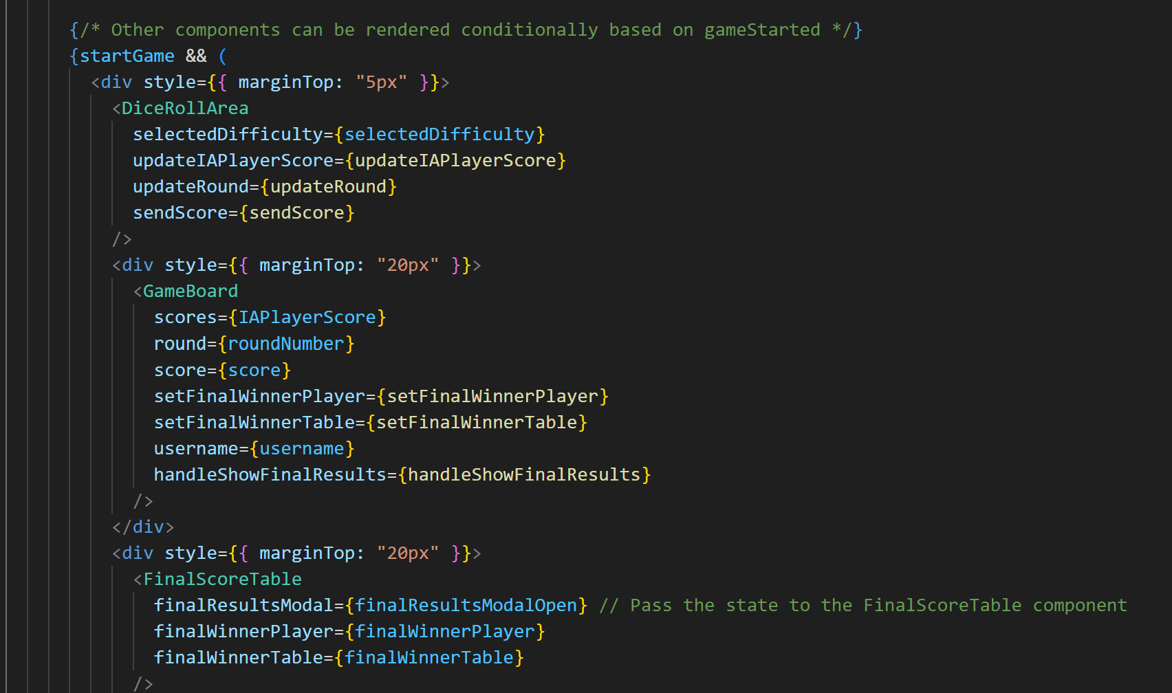
Design
Modular

Slide 11
Design
Testing

Slide 12





Learnings
Details to remember
Importance of Detailed Planning Documentation
Importance of Version Control
Small aspects can be a big challenge
Continuous Reviewing is Key

Slide 13

Thank you!
Team OMARK
Feel free to approach us
if you have any questions.

